Slide 1
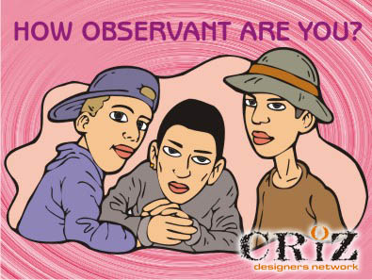
You will have 30 seconds to look at the next picture…

Slide 2
READY?

Slide 3
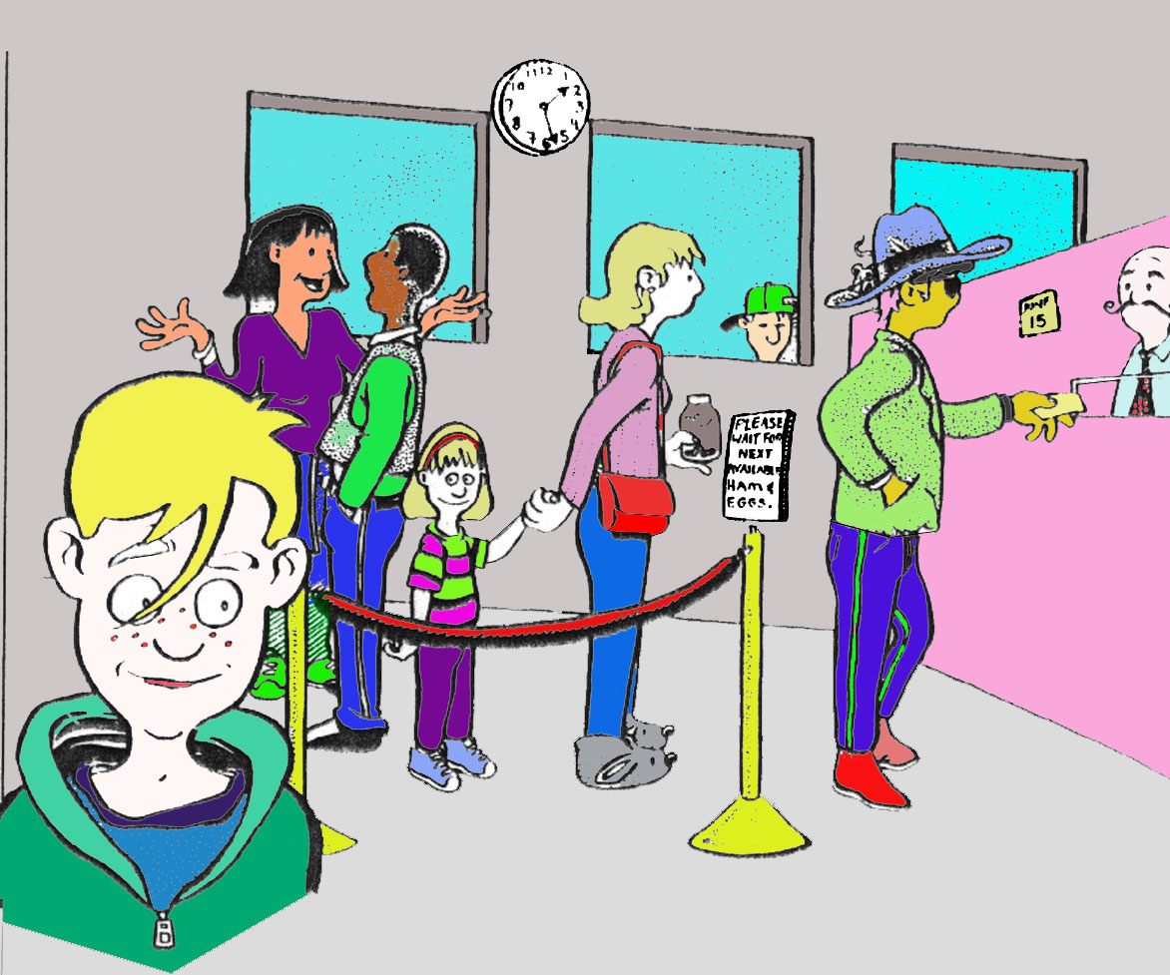

Slide 4
Now, in your notebook, answer the following questions
A) What time was it on the clock?
B) How many people were in the scene?
C) How many were males? Females?
D) Describe the person at the front of the line? Was it a man or woman? Was he or she wearing a hat? What kind of clothes was the person wearing? Could you tell how tall the person was? Did he or she have any distinguishing features?
E) What day of the month was it?
F) Did you see anything unusual in the picture?

Slide 6
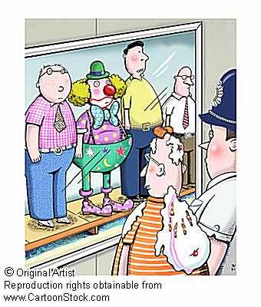
How Observant Are Other People?

Slide 7
Observers in the class will have 30 seconds to view the next picture.
Investigators should not look at the picture.

Slide 8
READY?

Slide 9
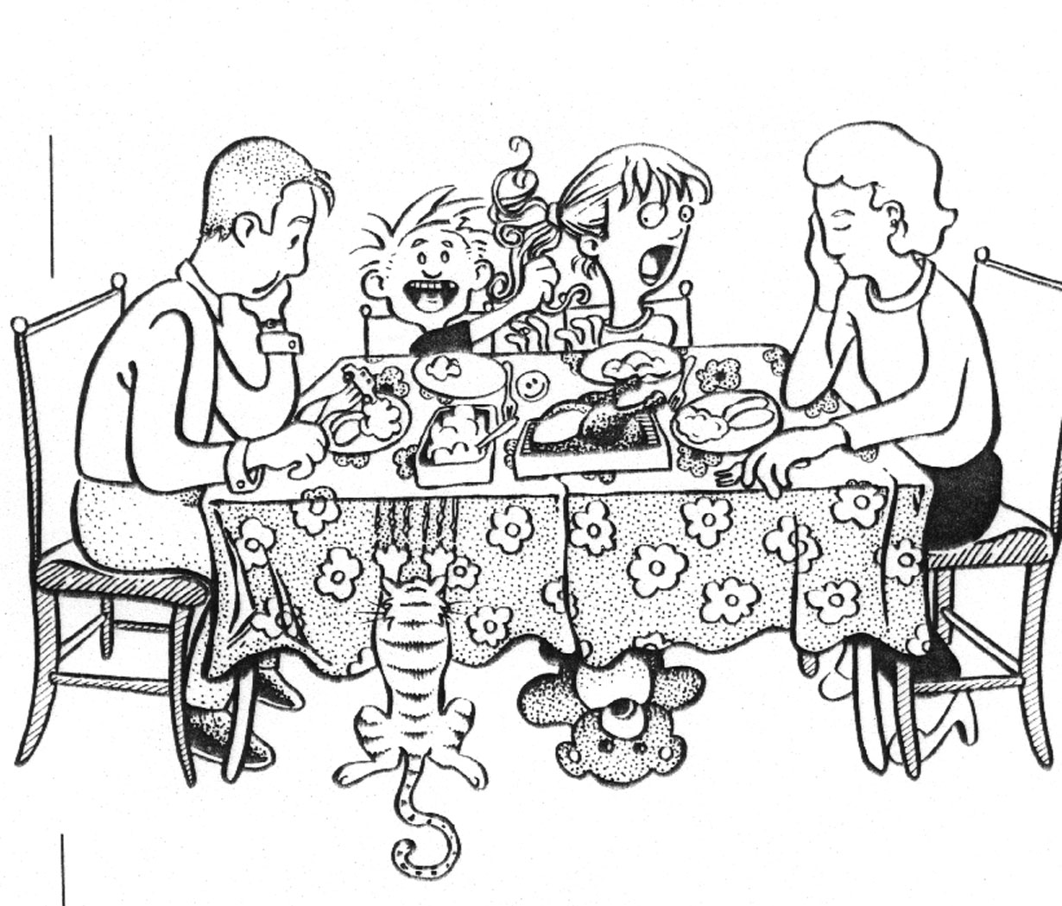

Slide 10
Now, investigators will have 5 minutes to ask the observers questions and draw a sketch of the scene.

Slide 11
Observers and investigators switch roles and repeat the exercise….

Slide 12
READY?

Slide 13
